Slide 1

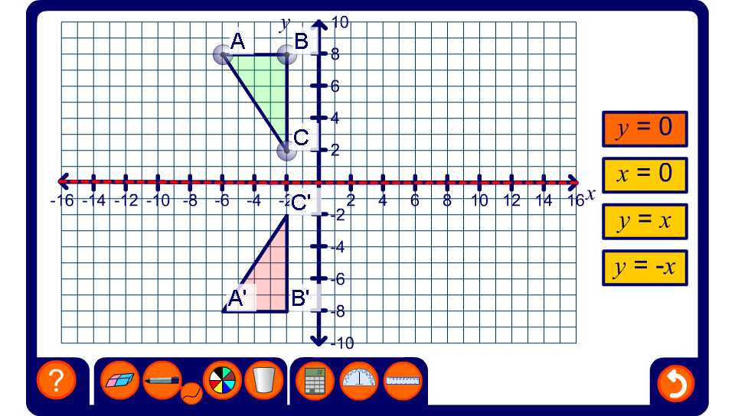


Reflection on a coordinate grid
Notes:
Investigate the relationship between the coordinates of the object and its image for each line of symmetry. This can be done by revealing the coordinate of A and A’ say, moving the shape (or the point) around the grid and observing the change in the coordinates.
Pupils should notice that when a shape is reflected in the y-axis, the x-coordinate of each image point is the same as the x-coordinate of the original point × –1 and the y-coordinate of the image point is the same as the y-coordinate of the original point. In other words, the x-coordinate changes sign and the y-coordinate stays the same.

